Slide 1
BMD ENG 301 Quantitative Systems Physiology (Nervous System)
Upper Motor System
2022_v2
Professor Malcolm MacIver

Slide 2
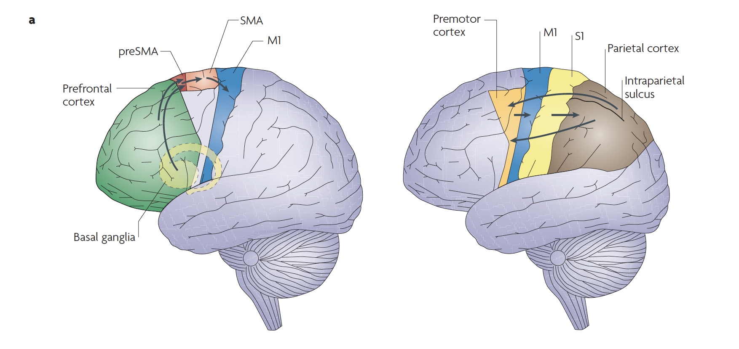
dPM: dorsal pre-motor cortex
M1: primary motor cortex
PF: prefrontal cortex
SMA: supplementary motor area
S1: primary somatosensory cortex
V1: primary visual cortex
BG: basal ganglia
C: cerebellum
RF: reticular formation
RN: red nucleus
VN: vestibular nucleus
Figure on right: Haggard 200i, ‘Human volistion’

Slide 3
dPM: dorsal pre-motor cortex
M1: primary motor cortex
PF: prefrontal cortex
SMA: supplementary motor area
S1: primary somatosensory cortex
V1: primary visual cortex
BG: basal ganglia
C: cerebellum
RF: reticular formation
RN: red nucleus
VN: vestibular nucleus
Figure on right: Haggard 200i, ‘Human volistion’

Slide 4
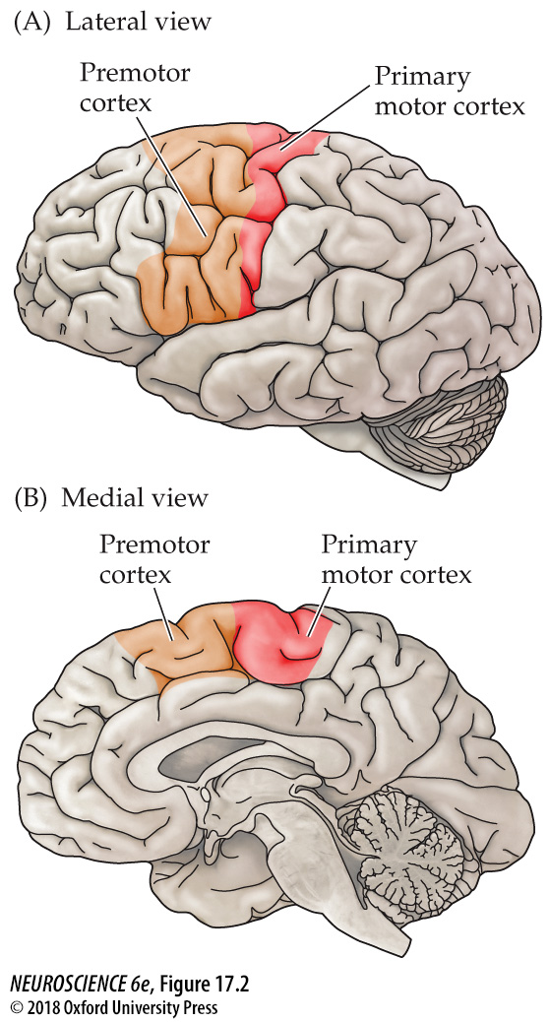
Primary motor cortex and premotor areas in the human cerebral cortex
CENTRAL MOTOR PROGRAM
Identification of task to perform
Plan of action - includes translation into the motor control program
Execution of the plan

Slide 5
Inputs to the primary motor cortex
SMA
MOTOR
dPM
S1
Motor Cortex
Brodmann
Area 5
vPM
SENSORY

Slide 6
Roles performed
Plan of action
Identification of the action to perform
Execute

Slide 7
Roles performed
Plan of action
Identification of the action to perform
Execute
Motor control signals

Slide 8
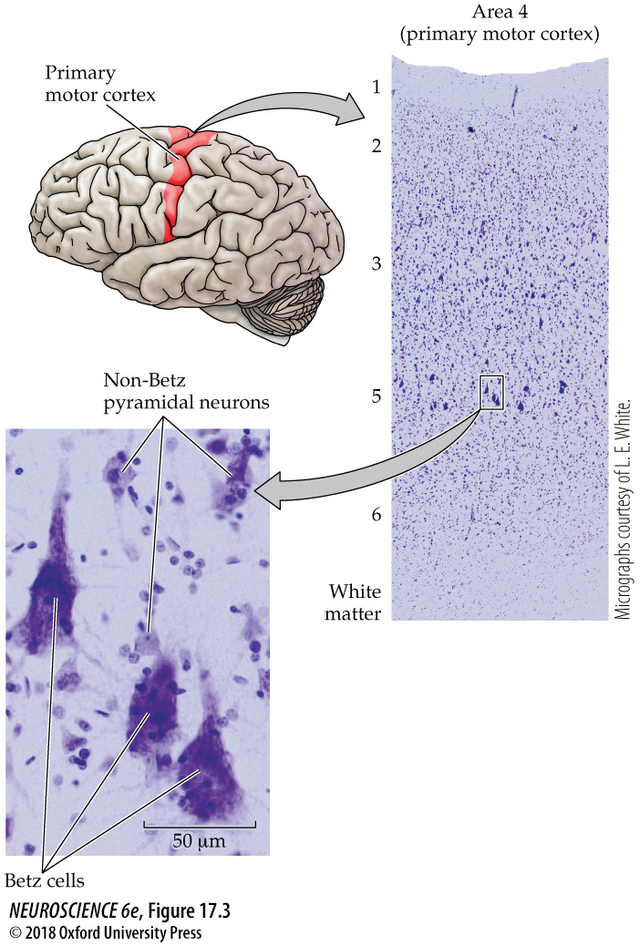
Cytoarchitectonic appearance of the primary motor cortex in the human brain

Slide 9
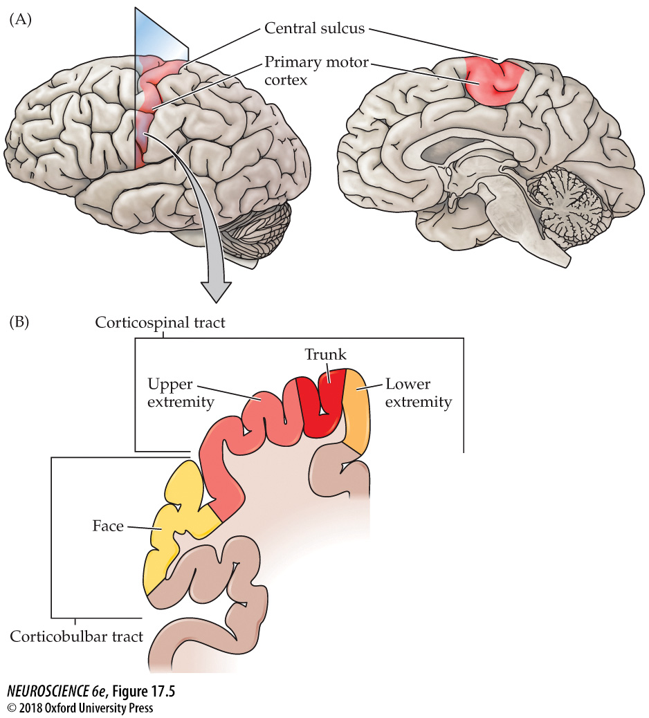
Topographic map of movement in the primary motor cortex

Slide 10
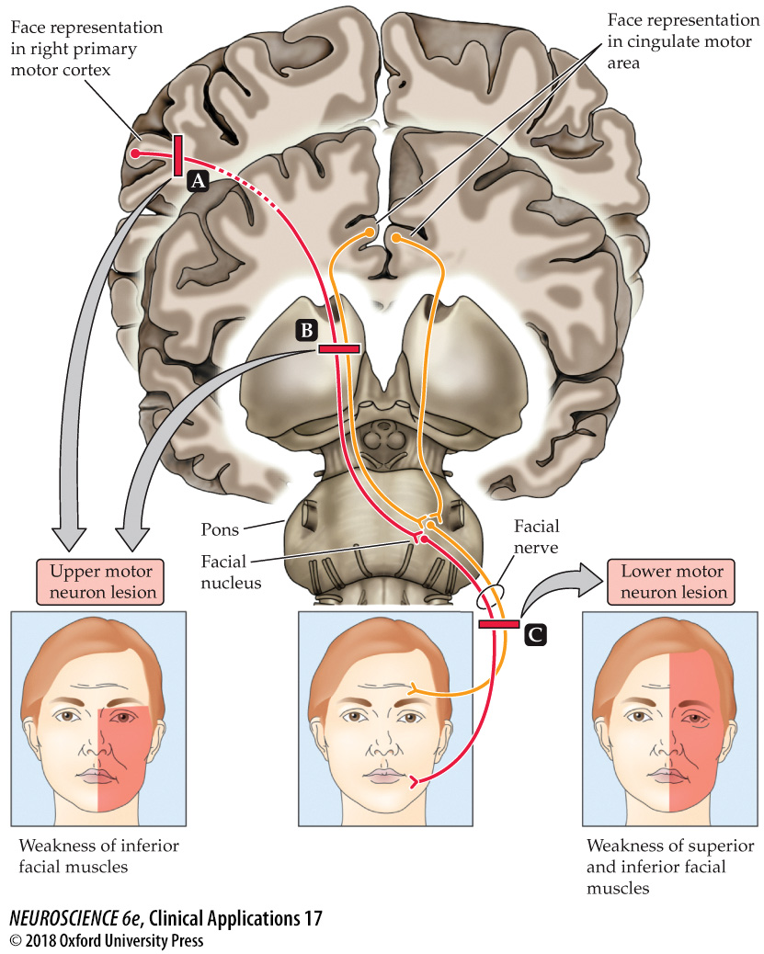
Patterns of facial weakness and their importance for localizing neurological injury

Slide 11
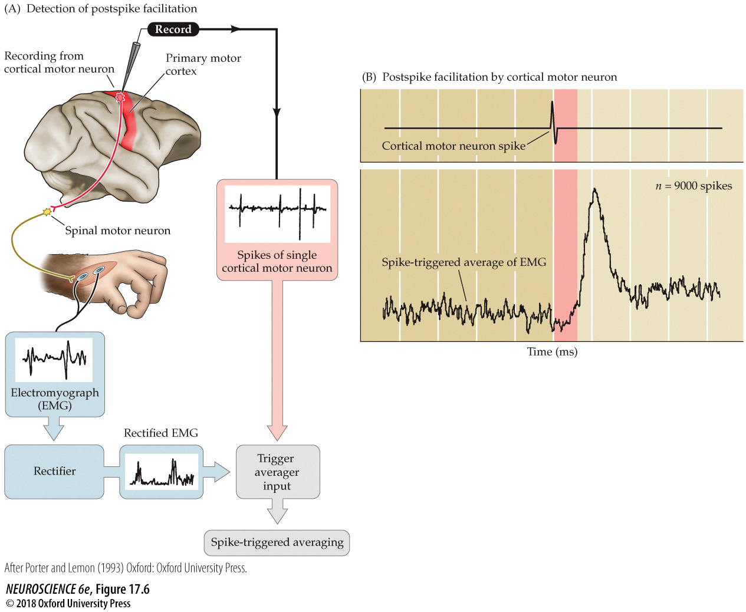
The influence of single cortical upper motor neurons on muscle activity

Slide 12
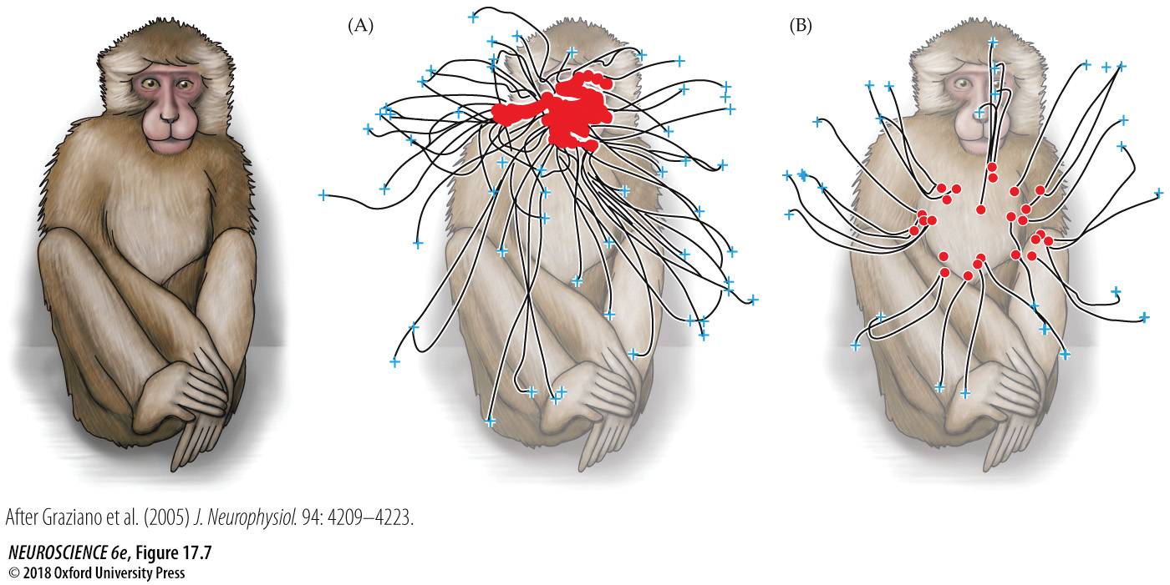
Purposeful movements of the contralateral arm and hand in a macaque monkey

Slide 13
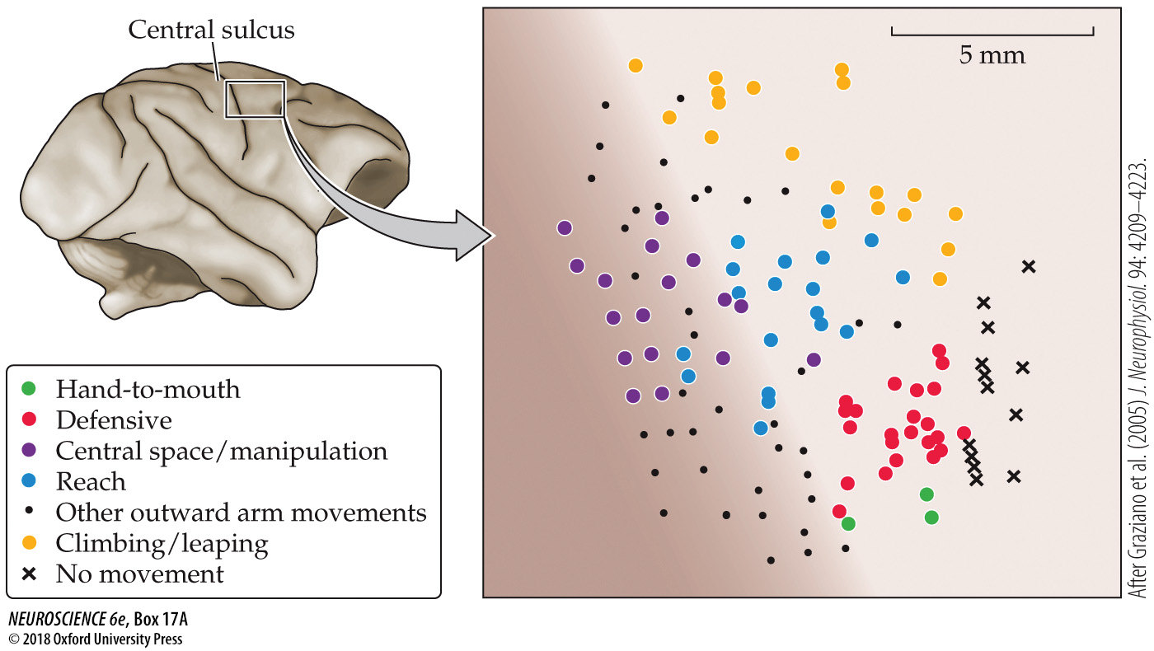
What do motor maps represent?

Slide 14
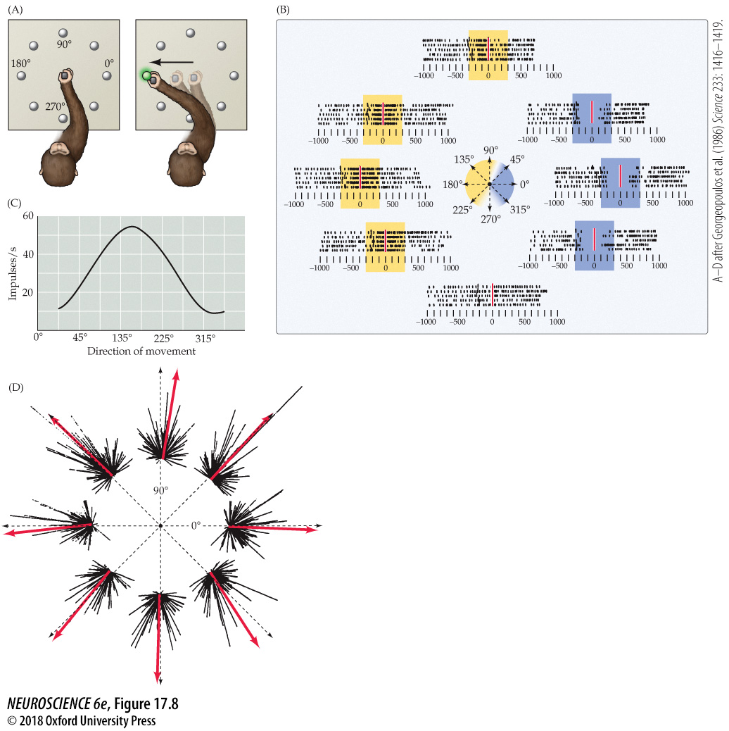
Directional tuning of an upper motor neuron in the primary motor cortex

Slide 15
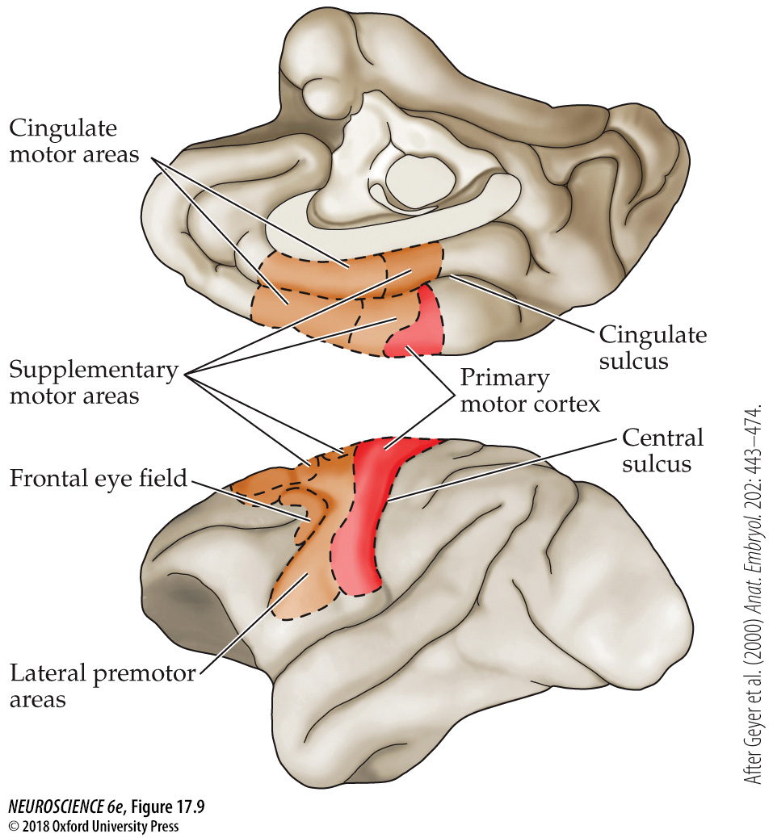
Divisions of the motor cortex in the macaque monkey brain

Slide 16
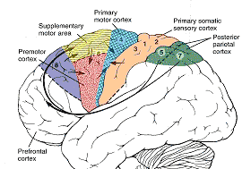
Inputs to the premotor cortex
Multisensory information from the inferior and superior parietal lobules
Motivation and intention information from the rostral divisions of the frontal lobe

Slide 17
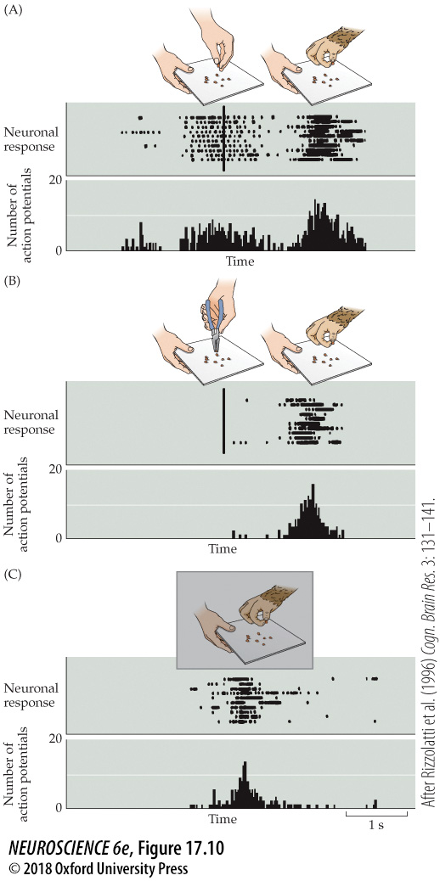
Mirror motor neuron activity in a ventral-anterior sector of the lateral premotor cortex

Slide 18
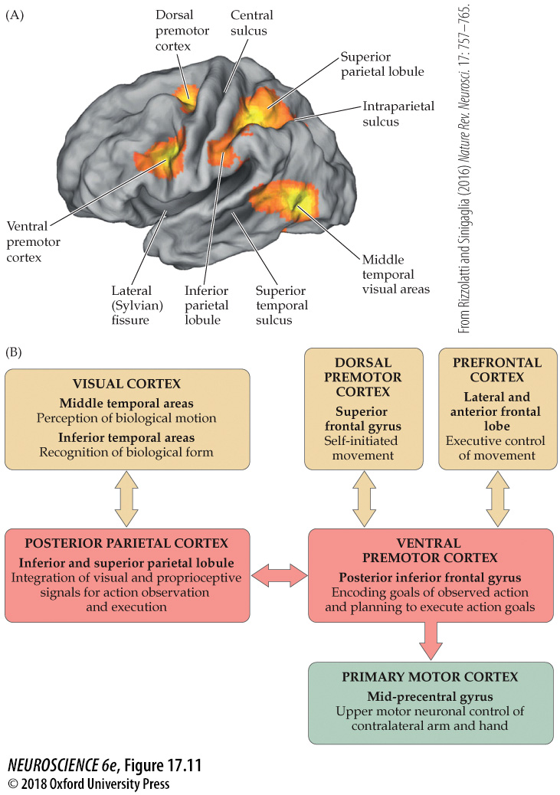
Descending projections from the brainstem to the spinal cord

Slide 19
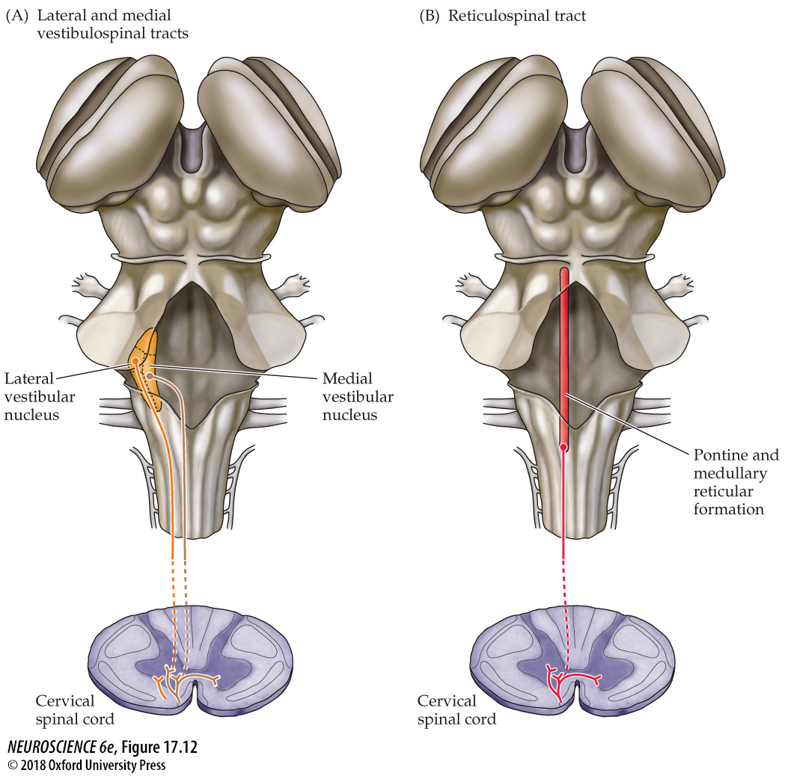
Descending projections from the brainstem to the spinal cord

Slide 20
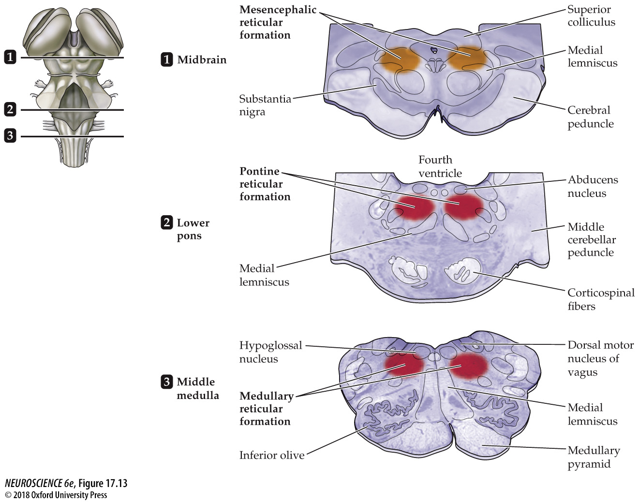
Location of the reticular formation

Slide 21
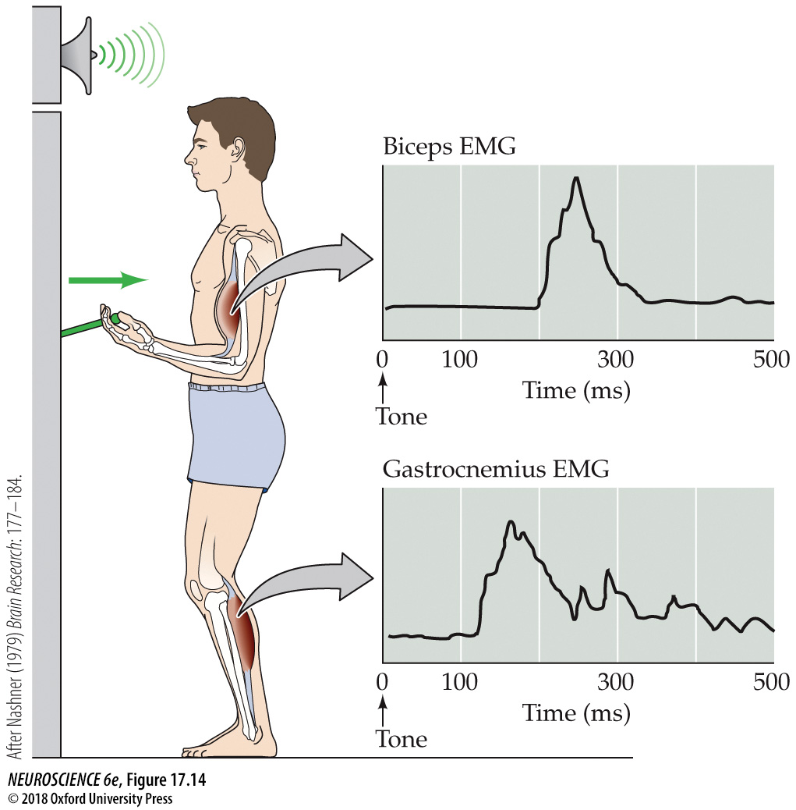
Anticipatory maintenance of body posture

Slide 22
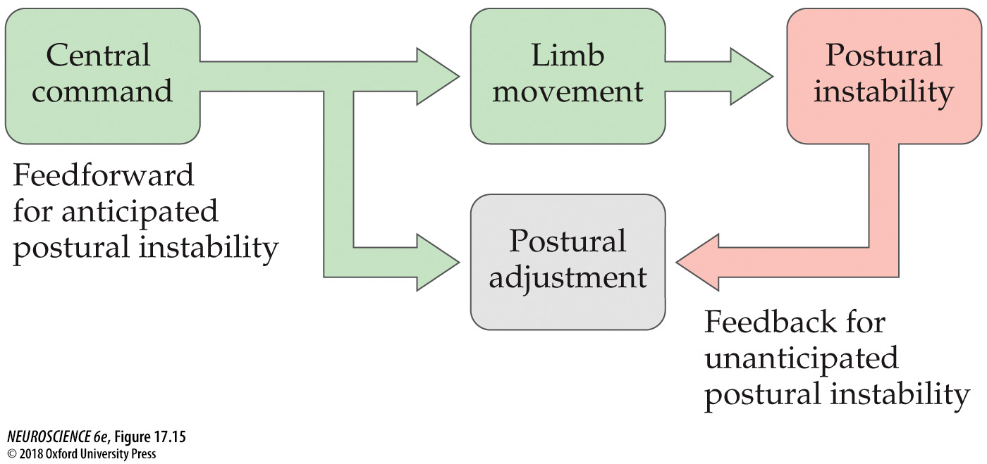
Feedforward and feedback mechanisms of postural control

Slide 23
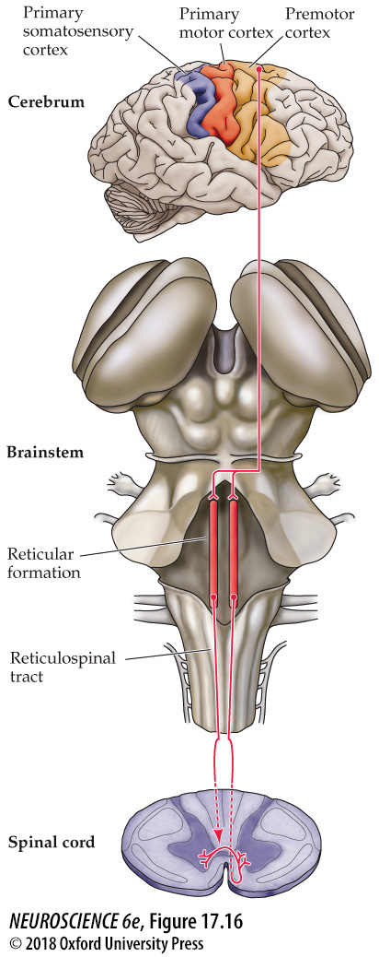
Indirect pathways from the motor cortex to the spinal cord

Slide 24
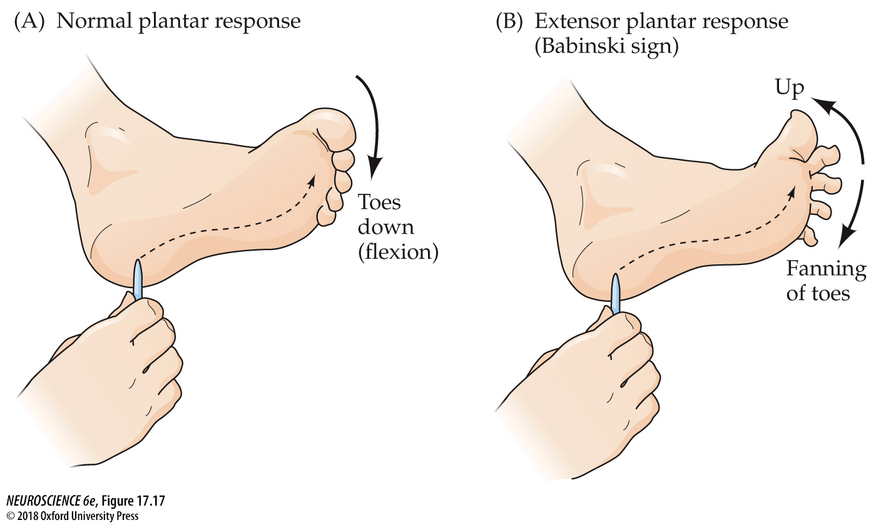
The Babinski sign

Slide 25
